Slide 1

Concrete Cracks Image Classification
AML 3104 - Neural Networks and Deep Learning

Slide 2

Introduction
Widespread Use: Concrete is the most extensively used building material globally due to its considerable compressive strength, making it the foundational element in a vast array of structures, from residential buildings to large-scale infrastructure.
Advantages: Concrete is highly favored for its durability and the flexibility it offers in forming various shapes, which makes it suitable for diverse construction needs.
Structural Importance: Concrete serves as the backbone for many critical structures, including dams, highways, and residential buildings, indicating its vital role in modern construction and infrastructure.
Environmental Resistance: Concrete boasts a remarkable resistance to water, weathering, and fire, which ensures its integrity and functionality in a variety of environmental conditions, from underwater applications to fire-prone areas. This resilience contributes significantly to the longevity of structures built with concrete, making it a reliable choice for any setting.

Slide 3

Problem With Concrete
Vulnerability to Cracks: Despite its strong properties, concrete is prone to degradation, particularly cracking, which can compromise structural integrity.
Causes of Cracking: Cracks in concrete can arise from multiple sources including thermal expansion and contraction, shrinkage, stress concentrations, and external loads.
Importance of Early Detection: Detecting cracks early is crucial for the safety of structures made of concrete. It not only helps in preventing further damage but also extends the lifespan of these structures.
Maintenance and Repair: Early detection facilitates timely maintenance and repairs, which are essential for sustaining the structural health and functionality of concrete buildings and infrastructures.
Impact on Safety and Durability: Timely addressed cracking can significantly influence the safety, durability, and longevity of concrete structures, thus maintaining their usability and preventing potential failures.

Slide 4
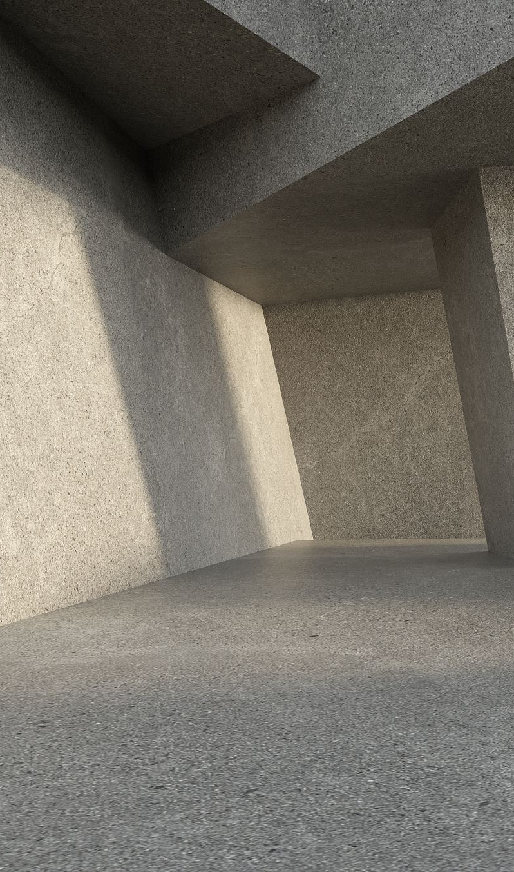
Data Collection
The concrete crack dataset contains images from METU campus buildings, aiding the training of machine learning models to detect structural cracks for automated health monitoring.
The dataset is structured into two main categories:
1. Negative Crack Images: These images represent concrete surfaces without any cracks. Including these images in the dataset is crucial for teaching the model what a crack-free concrete surface looks like.
2. Positive Crack Images: These are the images that contain visible cracks on the concrete surfaces. These images are vital for training the model to accurately identify different types of cracks.
Each category contains 10,000 images
The images are standardized to a size of 227 x 227 pixels and are in RGB color format.
https://data.mendeley.com/datasets/5y9wdsg2zt/2

Slide 5

Preprocessing
Rescaling pixel values to a range of [0,1], with normalization factor n=255.
Splitting the data into training and validation sets with a validation split of 20% (n=0.2).
Applying mild transformations such as rotation, width and height shifts, shearing, and zooming to increase dataset variability, with a magnitude of 10% (n=10%).
Utilizing horizontal flipping (n=True) to further augment the dataset.
Employing the 'nearest' fill mode during augmentation to interpolate new pixels from the nearest existing ones, ensuring minimal distortion of image features.

Slide 6
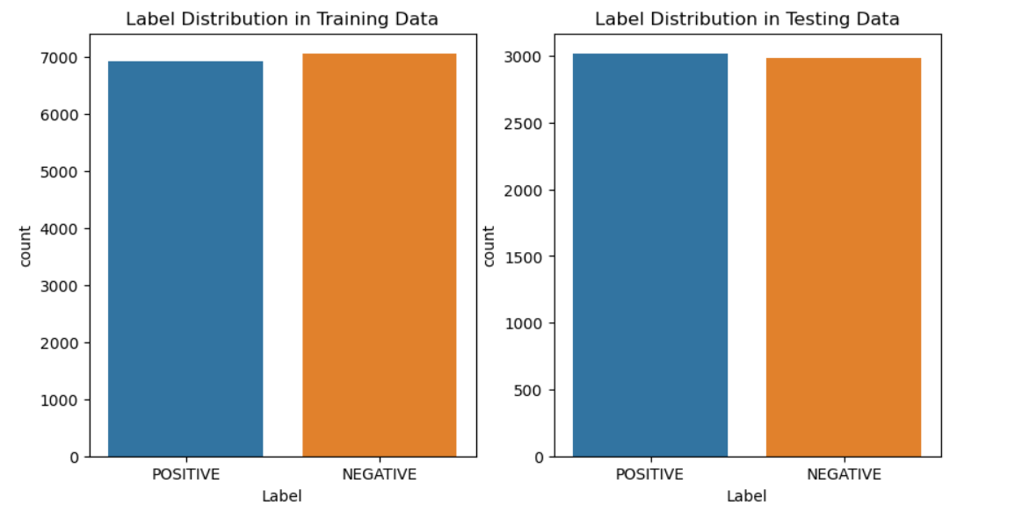
Data Distribution

Slide 7

Models used
CNN(Convolutional Neural Network)
Logistic Regression
Decision Tree

Slide 8
Accuracy of models
 | CNN | Logistic Regression | Decision Tree
Accuracy(train) | 97.89% | 98% | 94%
Accuracy(test) | 97% | 80% | 88%

Slide 9
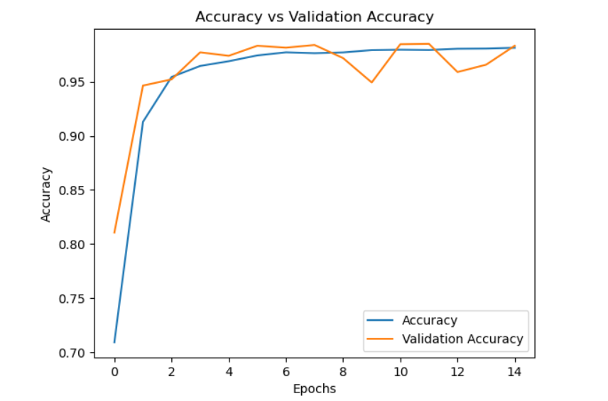

Slide 10
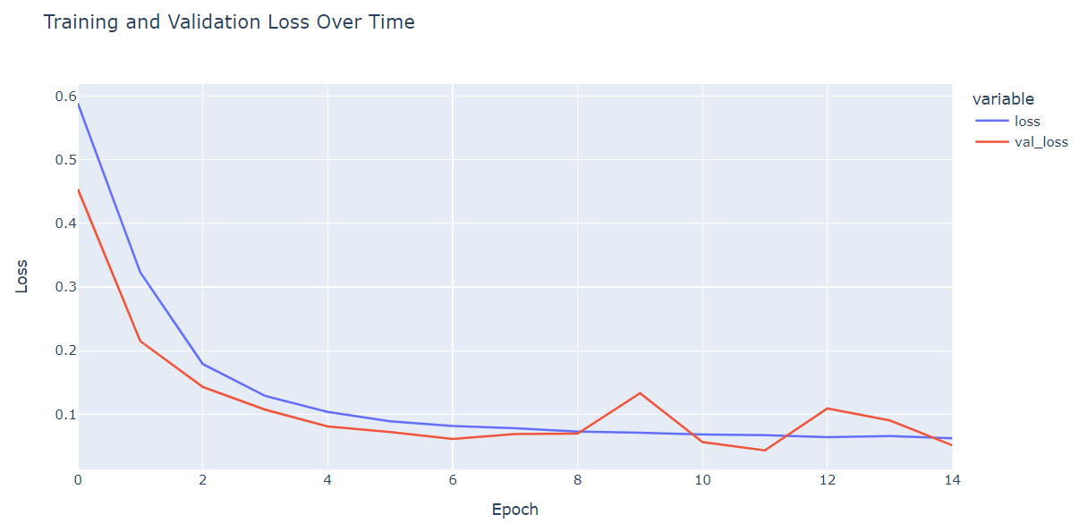

Slide 11
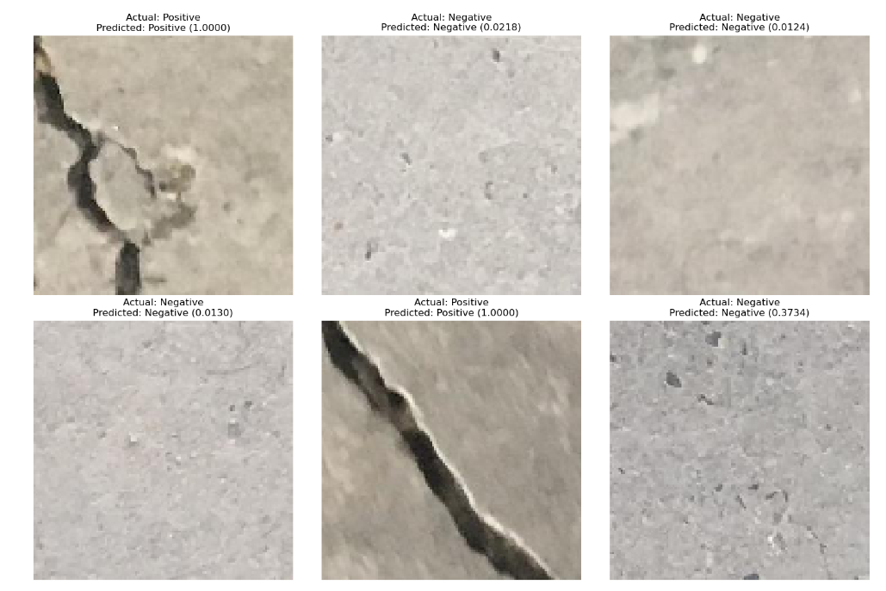
Random Sampling

Slide 12

Thank You

